Slide 1
Machine Learning Pipelines
From Raw Data to Scalable AI Architectures
Session 1 & 2

Slide 2
Session 1: Foundations
Beginner to Intermediate Pipeline Concepts

Slide 3

Intro to ML Pipelines
•
A machine learning pipeline is a structured workflow that automates the lifecycle of a model.
•
It consists of sequential steps transforming raw materials (data) into a functional product (prediction).
•
Pipelines eliminate manual interventions, ensuring repeatability and consistency across training runs.
•
They bridge the gap between isolated data science experiments and production-ready enterprise software.

Slide 4


Manual vs. Automated
Manual Workflows
Automated Pipelines
Data scientists run isolated Jupyter notebooks. Code is executed cell-by-cell. Hard to reproduce results. Prone to the "it worked on my machine" problem when handing off to engineering.
Code, data, and configurations are encapsulated into modular steps. Execution is orchestrated automatically. Highly scalable, repeatable, and ready for continuous deployment.

Slide 5






Benefits of Pipelines
Repeatability
Scalability
Reliability
Ensures that model training is identical every time it runs, eliminating human error and inconsistencies.
Designed to handle massive increases in data volume or user inference requests without degrading system performance.
Automated checks for data quality and model performance identify issues before they impact business operations.

Slide 6
The Assembly Line Analogy
Raw Materials: Unstructured and structured data enter the system.
Processing Stations: Data is cleaned, transformed, and engineered into features sequentially.
Quality Control: Models are trained and rigorously evaluated against baseline metrics.
Final Output: A deployable predictive model emerges, ready to serve end-users reliably.

Slide 7


Core Stages of a Pipeline
A standard machine learning pipeline is modular. Each stage has a specific input and output, allowing teams to update individual components without rebuilding the entire system.
The primary stages typically include Data Collection, Preprocessing, Feature Engineering, Model Training, Evaluation, and Deployment.

Slide 8

Data Collection
Every pipeline begins with data ingestion. This stage involves sourcing raw data from databases, APIs, IoT sensors, or web streams.
Data validation occurs immediately. The system flags anomalies like missing values or schema drift to prevent downstream model degradation.

Slide 9



Data Sources & Types
Structured
Unstructured
Streaming
Relational databases (SQL), CSV files, and spreadsheets containing highly organized tabular data.
Text documents, emails, images, and video files that require complex parsing and feature extraction.
Real-time data from IoT devices, server logs, or live social media feeds requiring continuous ingestion.

Slide 10
Data Preprocessing
Cleaning: Removing duplicate records, correcting erroneous entries, and standardizing formatting.
Missing Values: Handling nulls through imputation (mean, median) or deletion to maintain dataset integrity.
Scaling: Normalizing or standardizing numerical values so algorithms don't heavily weight larger numbers.
Encoding: Converting categorical text labels (e.g., "Red", "Blue") into numerical representations.

Slide 11
Handling Missing Data
Strategy | Description | Best Use Case
Drop Rows | Remove any row with a missing value. | Massive datasets where missing data is negligible.
Mean/Median Imputation | Replace missing values with the column average or middle value. | Continuous numerical data without extreme outliers.
Mode Imputation | Replace missing values with the most frequent value. | Categorical or highly skewed numerical data.
Predictive Imputation | Use a separate ML model to predict the missing value. | Complex datasets where feature relationships are strong.

Slide 12
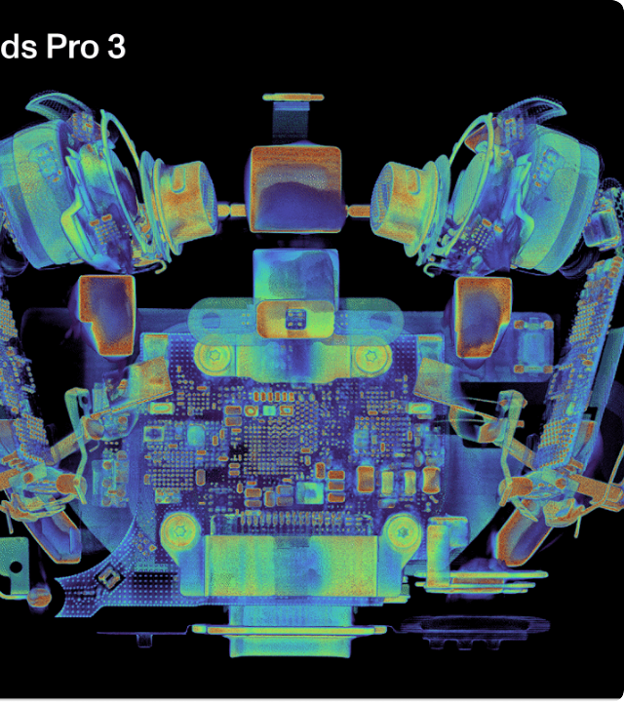
Feature Engineering
Raw data is rarely ready for algorithms. Feature engineering extracts the most relevant signals to improve model accuracy.
Experienced practitioners note that exceptional feature engineering often yields better results than merely switching to a more complex algorithm.

Slide 13



Engineering Techniques
Creation
Extraction
Selection
Generating new features not present originally, such as calculating 'Body Mass Index' from height and weight.
Pulling specific parts from complex data, like extracting the 'Month' and 'Day' from a full timestamp.
Removing irrelevant or redundant features to reduce noise and improve model training speed and performance.

Slide 14



Data Splitting
Training Data (70%)
Validation Data (15%)
Testing Data (15%)
Separating data ensures the model is evaluated on unseen information, preventing overfitting and providing a true measure of performance.

Slide 15
Model Selection
Decision Trees & Forests: Great for tabular data, capturing non-linear relationships with high interpretability.
Linear/Logistic Regression: Excellent baselines for continuous prediction or binary classification tasks.
Neural Networks: Ideal for complex unstructured data like images, audio, and natural language text.
Ensemble Methods: Combining multiple weak models (e.g., Gradient Boosting) to create a highly accurate strong learner.

Slide 16

Model Training
The chosen algorithm is fed the prepared training data to learn underlying patterns and relationships.
This phase is computationally intensive. The model adjusts its internal weights iteratively to minimize the error between its predictions and actual targets.

Slide 17
Training vs. Validation
The Training Phase
The Validation Phase
The model actively learns from this data. It minimizes a loss function by comparing its predictions to the ground truth. Over-optimizing here leads to memorization rather than generalization.
Used to tune the model's architecture. The model does not learn from this data; instead, we use it to check performance and adjust hyperparameter settings to prevent overfitting.

Slide 18
Model Evaluation
Accuracy: The percentage of total correct predictions. Can be misleading if dataset classes are heavily imbalanced.
Precision: Out of all positive predictions made, how many were actually correct? Crucial when false positives are costly.
Recall (Sensitivity): Out of all actual positive cases, how many did the model find? Crucial when false negatives are dangerous.
F1-Score: The harmonic mean of Precision and Recall, providing a single metric that balances both concerns.

Slide 19
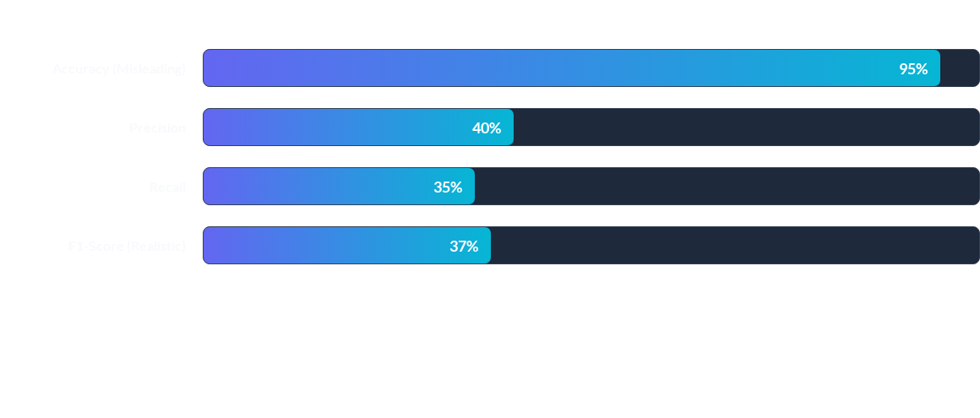
Evaluating Imbalanced Data
Example: A fraud detection model might boast 95% accuracy by simply guessing "Not Fraud" every time, but Precision and F1-Score reveal its true failure to detect actual fraud.

Slide 20
Regression Metrics
Metric | Definition | Interpretation
MAE (Mean Absolute Error) | Average of absolute differences between prediction and actual. | Highly interpretable; shows average error in original units.
MSE (Mean Squared Error) | Average of squared differences. | Heavily penalizes large errors/outliers due to squaring.
RMSE (Root Mean Squared Error) | Square root of MSE. | Penalizes large errors but returns to original data units.
R-Squared (R²) | Proportion of variance explained by the model. | Scores from 0 to 1; higher indicates better fit to the data.

Slide 21



Hyperparameter Tuning
What are they?
The Goal
Automation
Settings configured before training begins (e.g., learning rate, max tree depth) that control the learning process itself.
To find the optimal combination of these settings that yields the highest performance on the validation dataset.
Tuning is automated within the pipeline to iteratively search through parameter spaces without manual guessing.

Slide 22


Grid vs. Random Search
Grid Search
Random Search
Exhaustively tests every single possible combination of predefined hyperparameters. It guarantees finding the best combination within the grid but is incredibly slow and computationally expensive for large parameter spaces.
Tests a random sampling of hyperparameter combinations within defined ranges. It is significantly faster and often finds a near-optimal solution with a fraction of the computational cost.

Slide 23
Scikit-Learn Pipelines
The standard: Scikit-learn provides a built-in `Pipeline` class to chain data transformations and estimators.
Chaining: Output of one step (e.g., Imputer) automatically becomes the input to the next (e.g., Scaler).
Prevents Data Leakage: Ensures transformations like scaling are only fit on training data, never on test data.
Clean Code: Calling `.fit()` on the pipeline executes all preprocessing and training steps sequentially.

Slide 24
Hands-on Lab 1
01
Building an End-to-End Pipeline
In this lab, you will construct a fully functional Scikit-Learn pipeline. You will handle missing values, encode categories, scale numerical features, and train a Random Forest model on the Titanic dataset, entirely in code.
Interactive Session

Slide 25
End of Session 1
Questions? Break Time.

Slide 26
Session 2: Advanced Architecture
MLOps, CI/CD, and Production Pipelines

Slide 27
Intro to MLOps
Definition: Machine Learning Operations (MLOps) is the standardization of ML lifecycle management.
Bridging Teams: Unites Data Scientists, DevOps, and Software Engineers to deploy models efficiently.
Goal: Reduce the time from model conception to production deployment while ensuring reliability.
Continuous Cycle: Focuses heavily on continuous integration, deployment, and automated retraining.

Slide 28
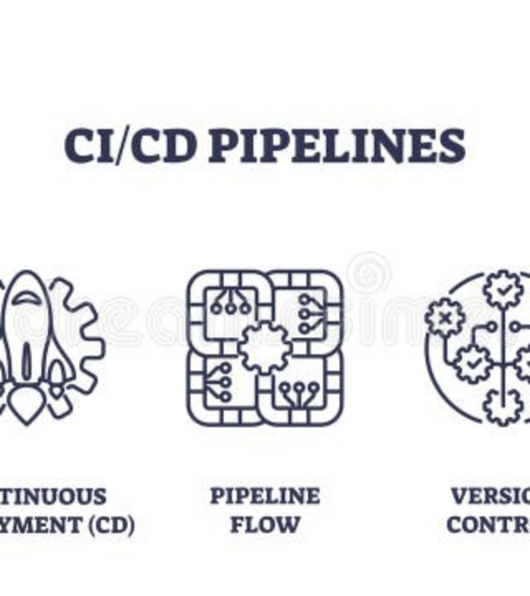
CI/CD for ML
Continuous Integration/Deployment is reimagined for ML. Code changes trigger automated testing of both code and model metrics.
Models must pass performance gates (e.g., accuracy > 90%) on validation sets before automated deployment to production.

Slide 29
DevOps vs. MLOps
Traditional DevOps
Machine Learning Ops
Focuses on code versioning, unit testing, and deploying static software artifacts. If the code passes tests and compiles, it works as expected. Performance degradation usually implies a hardware issue.
Focuses on versioning code, data, AND models. A model can "break" silently if real-world data changes, even if the code runs perfectly. Requires constant monitoring of predictive performance.

Slide 30

Version Everything
Git handles code, but MLOps requires data and model versioning to ensure reproducibility.
Tools like DVC (Data Version Control) and MLflow track exactly which dataset trained which model, maintaining a complete audit trail.

Slide 31
Training-Serving Skew
The Silent Killer: Occurs when data used during inference differs from data used during training.
Causes: Inconsistent preprocessing logic between the lab and production environments.
Result: Models perform exceptionally well in testing but fail silently in the real world.
Solution: Unify feature transformations so the exact same code runs during training and serving.

Slide 32



Feature Stores
Centralized
Consistency
Reusability
A central vault for storing documented, curated, and access-controlled machine learning features across the enterprise.
Eliminates training-serving skew by serving the exact same calculated features to both training jobs and real-time APIs.
Allows different data science teams to discover and reuse existing features rather than reinventing the wheel.

Slide 33
Orchestration Tools
DAGs: Pipelines are executed as Directed Acyclic Graphs, ensuring steps run in the correct order.
Apache Airflow: Python-based platform for scheduling and monitoring massive batch data pipelines.
Kubeflow Pipelines: Kubernetes-native orchestrator specifically built for containerized ML workflows.
Tracking: These tools provide UI dashboards to monitor pipeline health, retry failures, and track run metadata.

Slide 34



Containerization in ML
Docker
Environment
Microservices
Packages the ML model, pipeline code, and all system dependencies into a single, portable unit.
Guarantees that the pipeline runs identically on a developer's laptop as it does in the cloud production server.
Enables wrapping the model as a lightweight REST API endpoint, easily consumable by front-end applications.

Slide 35
Kubernetes for ML Workloads
Orchestrator: Manages clusters of Docker containers across distributed compute nodes.
Auto-Scaling: Automatically spins up extra servers during peak inference traffic and scales down to save costs.
GPU Management: Efficiently allocates specialized hardware (GPUs/TPUs) for intensive training jobs.
High Availability: Ensures models stay online by automatically restarting failed containers and balancing load.

Slide 36
Batch vs. Real-Time
Batch Inference
Real-Time Inference
Predictions are generated offline on a schedule (e.g., nightly). Suitable for high-volume tasks where latency is not an issue, such as generating weekly customer churn reports or marketing lists.
Predictions are generated instantly as data arrives via an API. Necessary when immediate action is required, such as credit card fraud detection or live website recommendations.

Slide 37

Stream Processing
For real-time pipelines, tools like Apache Kafka ingest continuous data streams in milliseconds.
Stream processing frameworks apply ML models on-the-fly, enabling instant insights and reactive AI behaviors before the moment passes.

Slide 38
Kappa Architecture
Single Path: A modern architectural pattern that processes all data (batch and real-time) through a single streaming pipeline.
Event Logs: Relies on immutable event logs (like Kafka) as the primary source of truth.
Replayability: Allows developers to "replay" historical data streams to retrain models or test new algorithms.
Simplification: Avoids the complexity of maintaining separate codebases for batch (Hadoop) and speed (Storm) processing layers.

Slide 39
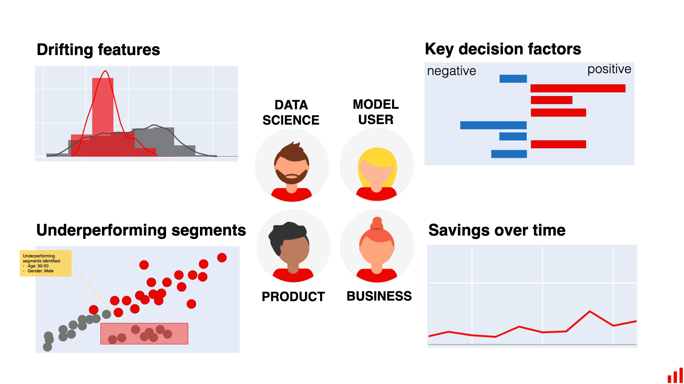
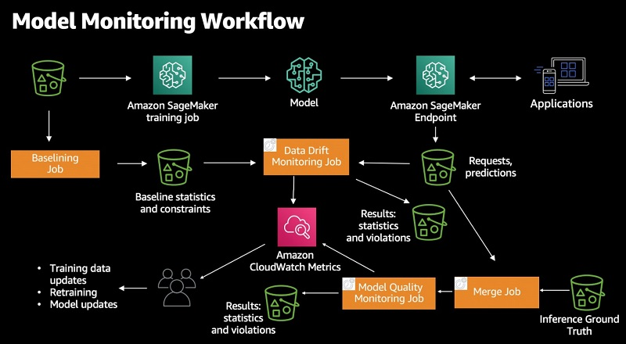
Model Monitoring
Deploying a model is only the beginning. Monitoring systems track prediction accuracy, latency, and system resource usage over time.
Custom dashboards surface these metrics, triggering alerts when performance drops below acceptable operational thresholds.

Slide 40






Data vs. Concept Drift
Data Drift
Concept Drift
Detection
The statistical distribution of incoming data changes over time. (e.g., a sudden influx of younger users altering demographic inputs).
The relationship between features and the target changes. (e.g., user purchasing habits fundamentally shift post-pandemic).
Pipelines must implement statistical tests on incoming streams to detect both drifts and trigger retraining automatically.

Slide 41
Automated Retraining Loop
2. Trigger
4. Deploy
Alert triggers the CI/CD pipeline to fetch new data.
If Challenger wins, it replaces Champion seamlessly.
1. Monitor
3. Train & Test
System detects data drift or significant accuracy drop.
Challenger model trained and evaluated against Champion.

Slide 42

Distributed Computing
Massive Data: When datasets exceed single-machine memory, pipelines must utilize distributed clusters.
Apache Spark: In-memory processing framework that splits ML tasks across hundreds of nodes (e.g., PySpark MLlib).
Distributed Training: Frameworks like TensorFlow and PyTorch sync gradients across multiple GPUs to speed up deep learning.
Cloud Services: Managed services like AWS EMR or Dataproc dynamically provision compute resources on demand.

Slide 43



AI Data Quality & Governance
Validity
Bias Audits
Privacy
Enforcing strict schema rules to ensure data conforms to expected structures before entering the model.
Continuous cohort analysis to flag underrepresented demographics, ensuring models remain fair and compliant.
Masking or hashing personally identifiable information (PII) within the pipeline before persistent storage.

Slide 44

Cloud ML Architecture
Modern pipelines leverage managed cloud platforms (AWS SageMaker, Azure ML, GCP Vertex AI).
These platforms provide end-to-end ecosystems, integrating feature stores, hyperparameter tuning, model registries, and endpoint serving without managing underlying infrastructure.

Slide 45
Case Study: Maintenance
The Problem
Pipeline Solution
Manufacturing equipment failures cause expensive unplanned downtime. Maintenance is historically reactive or strictly scheduled based on time, regardless of actual machine health.
Real-time IoT sensor data is ingested. An anomaly detection model monitors vibration/temperature. The pipeline triggers an ERP alert days before a failure, reducing downtime by 40%.

Slide 46
Case Study: Fraud Detection
The Challenge
Pipeline Solution
Financial institutions must approve or decline transactions within milliseconds. Fraud tactics evolve rapidly, requiring constant model adaptation without halting the payment network.
Streaming data pipelines leverage a feature store to combine transaction data with historical user behavior instantly. Automated retraining loops update the model weekly to combat new fraud patterns.

Slide 47
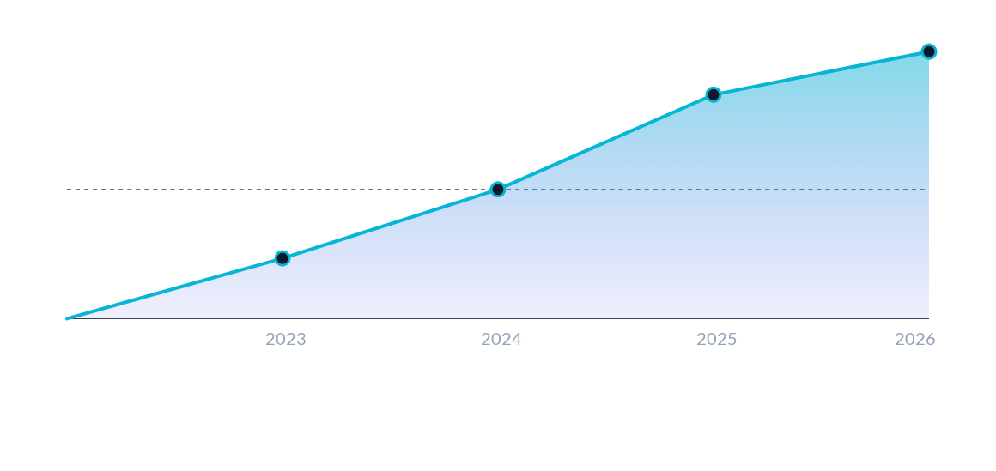
MLOps Adoption Growth
Enterprise adoption of automated MLOps pipelines has surged, moving from experimental scripts to critical IT infrastructure.

Slide 48
MLOps Maturity Levels
Level 1: Pipeline
Level 3: Full Ops
Automated training pipelines, manual deployment triggers.
Automated retraining based on real-time drift detection.
Level 0: Manual
Level 2: CI/CD
Ad-hoc scripts, manual deployment, no automation.
Fully automated CI/CD for model testing and deployment.

Slide 49
Hands-on Lab 2
02
Automated CI/CD Simulation
You will design a mock MLOps system. Your code will train a model, evaluate metrics, and programmatically decide whether to promote it to 'Production' based on hard accuracy thresholds, simulating a real-world continuous deployment gate.
Interactive Session

Slide 50
Questions?
Thank you for your attention.

